Slide 1
SAP BTP Build Apps Training
Day 3
Anubhav Oberoy
www.AnubhavTrainings.com
Follow excellence with sheer passion

Slide 2


DISCLAIMER
The training content and delivery of this presentation is confidential, and cannot be recorded, or copied and distributed to any third party, without the written consent of Anubhav Trainings

Slide 3
Agenda – Day 3
01
Build Apps introduction
02
Fiori vs Build Apps
03
Create and Test first Application

Slide 4
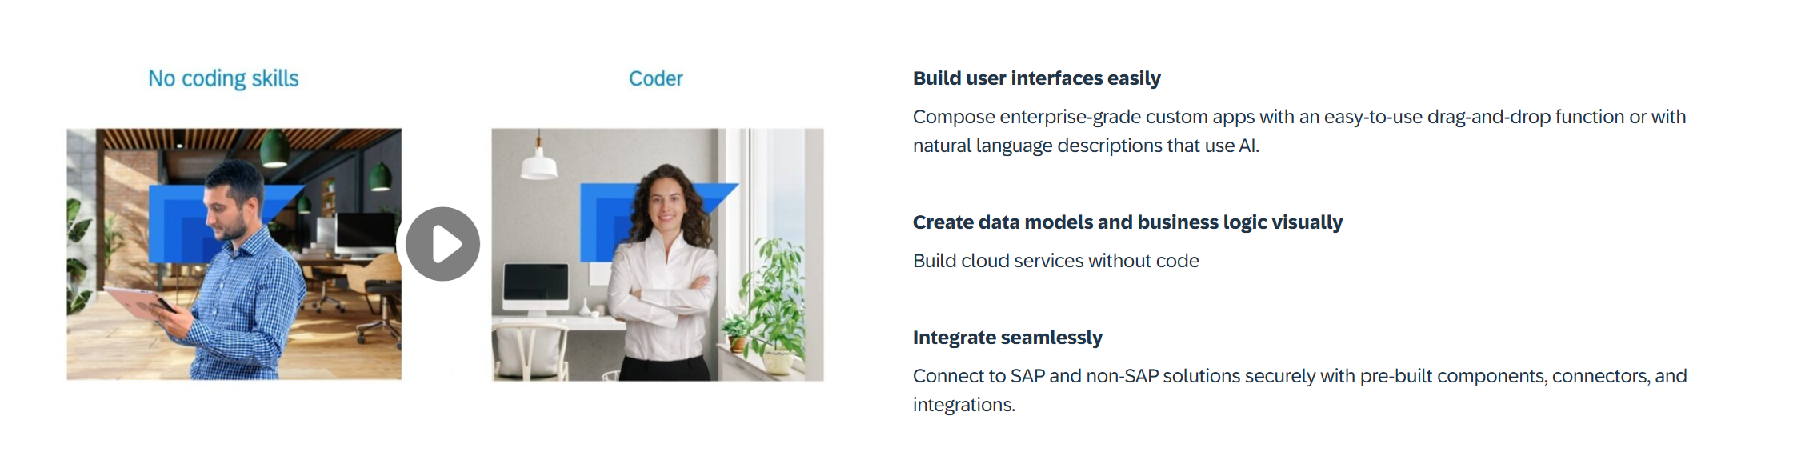
What is Build Apps?
SAP Build Apps is an AI-infused professional application development solution designed for anyone to quickly create apps without code regardless of role or skill level.

Slide 5
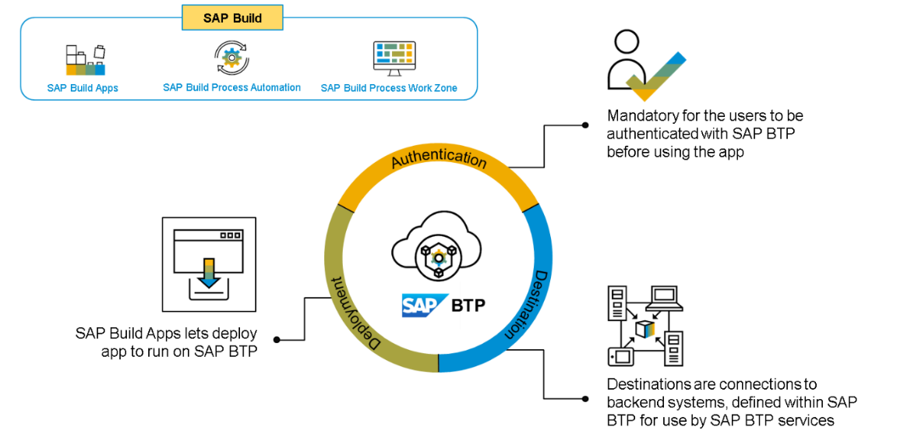
Core Capabilities?
Build Visually – SAP Build Capabilities enable customers to build visually, using drag-and-drop tools and intuitive interfaces. This allows users to quickly and easily design, configure, and deploy applications with no coding. By leveraging the SAP Build capabilities, customers can quickly create rich, interactive applications that streamline business processes, drive greater efficiency, and reduce operational costs. The tools are designed to be easy to use and are backed by a comprehensive library of pre-configured components, integration APIs, and data connectors.
Integrate Seamlessly – SAP Build capabilities help customers integrate their SAP solutions, applications, and systems with each other and with other systems and applications.
Collaborate Effectively – With its feature of seamless integration, SAP Build helps businesses leverage technologies like cloud-based tools with development teams to establish communication protocols like lifecycle management and built-in governance.

Slide 6
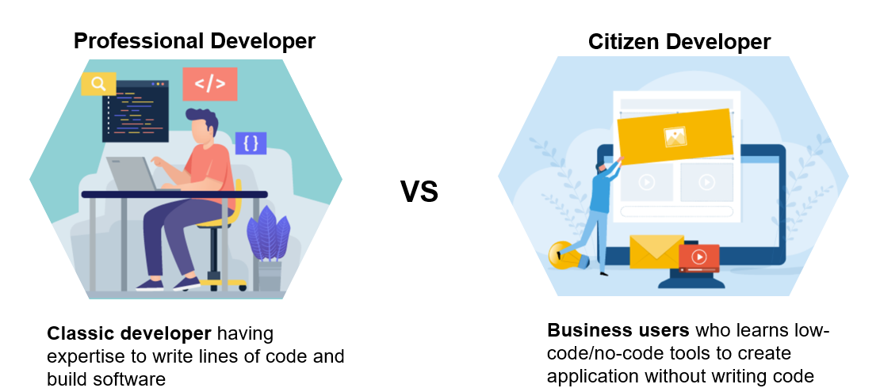
Who is the Build Apps for?

Slide 7
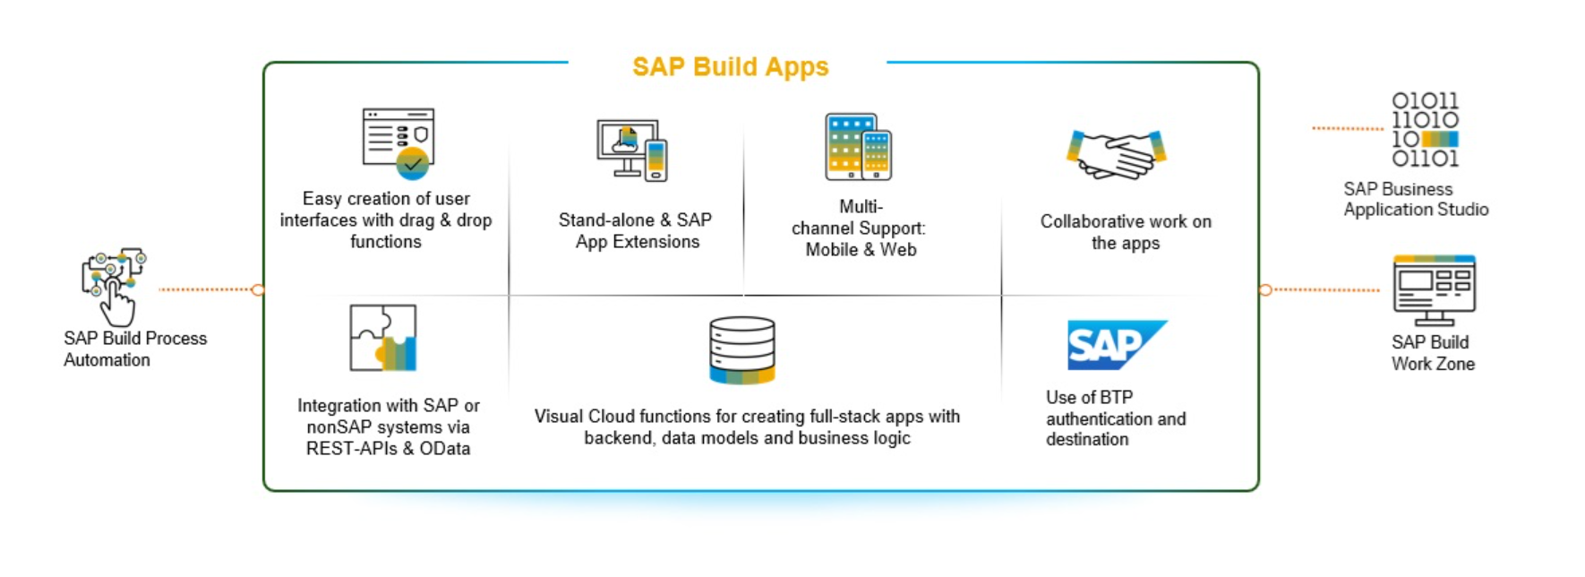
SAP Build Apps – Use Cases

Slide 8
SAP UI5 v/s SAP Build Apps
Aspect | SAP UI5 | SAP Build Apps
Development Approach | Full-code development (JavaScript, HTML, CSS) | Low-code/no-code (drag-and-drop, minimal code)
Target Audience | Frontend developers, UI/UX designers, SAP developers | Business users, citizen developers, IT teams
Customizability | Highly customizable, full control over design and logic | Flexible with limits; customization possible with code
Ease of Use | Requires programming knowledge (JavaScript) | Very user-friendly, no/less programming required
Platform Type | UI framework for building custom web apps, Suitable for both cloud and on-premise apps | Low-code platform for full app development (web, mobile) suitable for cloud and native apps
APK support | Using Cordova plugin | Direct support to extract the APK
UI Components | Advanced, enterprise-grade UI components | Pre-built, basic UI components for rapid development
Integration with SAP Systems | Seamless integration with SAP backend (S/4HANA, Fiori, etc.) | Integrates with SAP and non-SAP systems via APIs
Integration with Third-Party Systems | Typically requires custom development | Easy integration with third-party systems via APIs
Flexibility in Design | Full flexibility for custom designs and behaviors | Limited flexibility compared to full coding, but extensible with logic
Complexity | High, requires technical knowledge and expertise | Low, accessible for non-technical users
Speed of Development | Slower, due to custom coding and in-depth UI design | Faster, thanks to low-code/no-code approach
Cost | High | Less
Use Case | Custom, enterprise-level applications with detailed UI | Rapid prototyping and app development for business needs
Extensibility | Fully extensible with custom code | Extensible with custom code but within a low-code environment
Maintenance | Requires ongoing developer involvement for updates | Easier to maintain, especially for non-technical teams
Learning Curve | Steep learning curve for developers | Low learning curve for non-technical users

Slide 9
Key roles involved in the Business Process
The key roles involved in a business apps can be categorized as below
BuildAppsAdministrator:
This role grants full control over SAP Build Apps applications, including all functionalities and configurations.
BuildAppsDeveloper:
This role is for developers who can create, modify, and deploy applications within SAP Build Apps.
RegistryAdmin:
This role allows users to view and perform any actions on all projects, regardless of project-level authorizations.
RegistryDeveloper:
This role is for developers who can manage projects and registries.

Slide 10
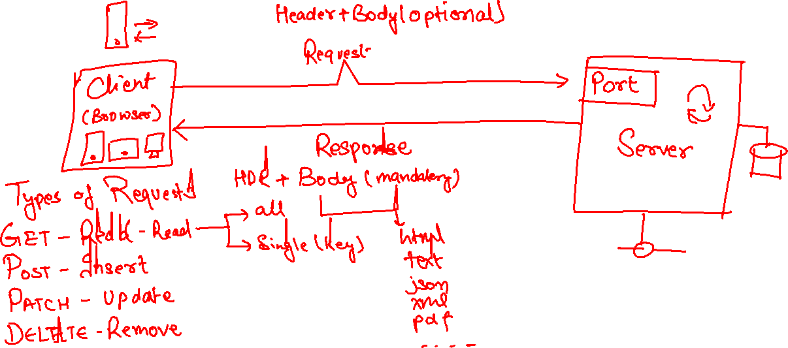
Client Server Model – How web Applications work

Slide 11
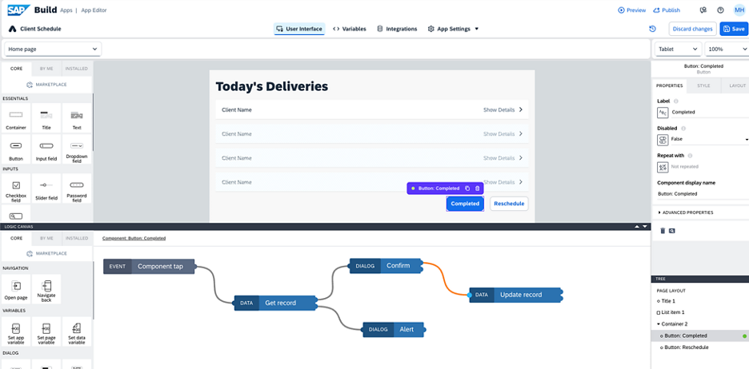
Architecture
<content>

Slide 12
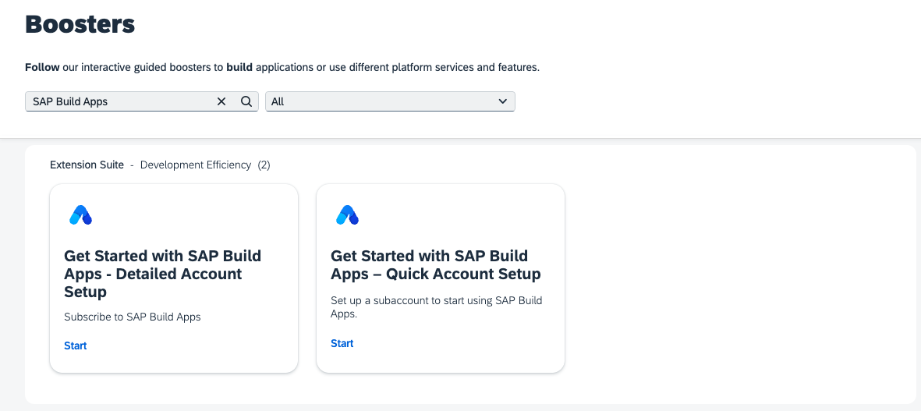
What is Build Apps Booster
To automatically subscribe, navigate to the Boosters tab in your Global account and search for Get Started with SAP Build Apps. At the moment, there are two boosters available: "Detailed Account Setup" and "Quick Account Setup". Choose Quick Account Setup if you're new to the SAP BTP platform or haven't set up a subaccount for SAP Build Apps yet. Detailed Account Setup gives you more control over the setup process and allows you to use an already created subaccount.

Slide 13

Hands-on Setup and overview of Build Apps

Slide 14
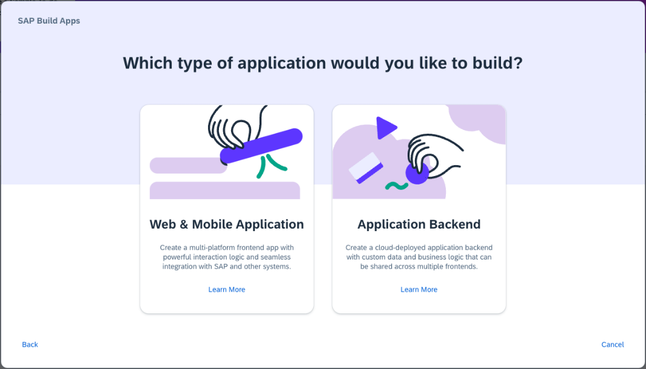
Core Components
Lobby – Centrally view and manage all build apps and business processes.
User Interface – design and develop the pages which includes UI elements such as text, input, radio etc.
Variables – define local and global variables to exchange and manage data of the running app
Integrations – Manage integrations and connections to 3rd party systems and servers such as S/4HANA
Navigation – Manage the side panel and navigation option for burger icon
Authentication – Control the authentication mechanism for allowing secure access for users
Theme – Build and apply custom theme for the application to give branding

Slide 15
Build Apps - Builder area
When working with SAP Build Apps, the majority of your time will be spent in the app builder area. This area allows you to complete key tasks such as, but not limited to, the following:
Build pixel-perfect user interfaces
Integrate with external data resources
Create complex logic with visual programming
Bind data to components to create dynamic views
Define navigation
https://help.sap.com/docs/BUILD_APPS/431746e4c663458aa68d9754b237bfc6/daece9f87abf4f7187a14ae0b1f8b2ab.html

Slide 16
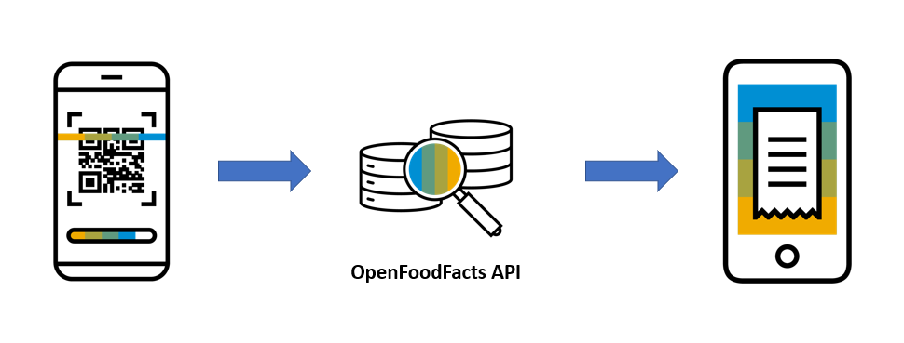
Logic Flows
Logic flows are used to capture events in an application, such as a page loading or a user tapping on a button, and to execute actions – for example, to change the value of data or to open the device’s camera.
To create a barcode scanning app, you need to configure a logic flow that tells your application to open the camera device once the user taps the Scan button. To do this, we’ll show you how to add the logic to the button, then how to take advantage of SAP Build Apps’s QR and Barcode component.
In the logic panel, you can see the Event - Component Tap, which is triggered when a user taps on the button. We now need to decide what this event will do.

Slide 17
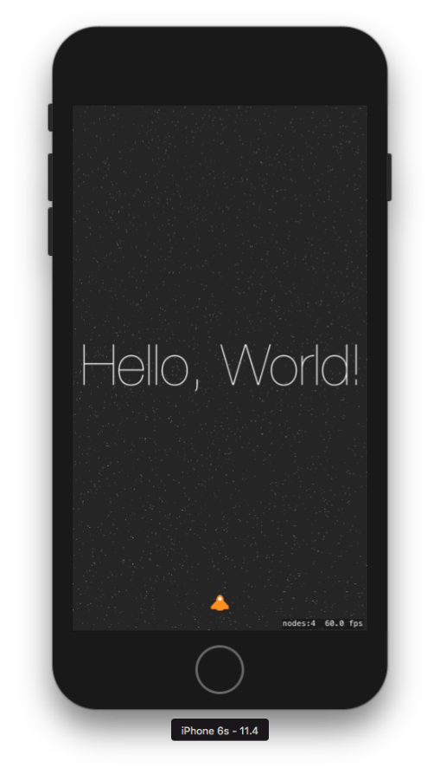
Create your first hello world application

Slide 18
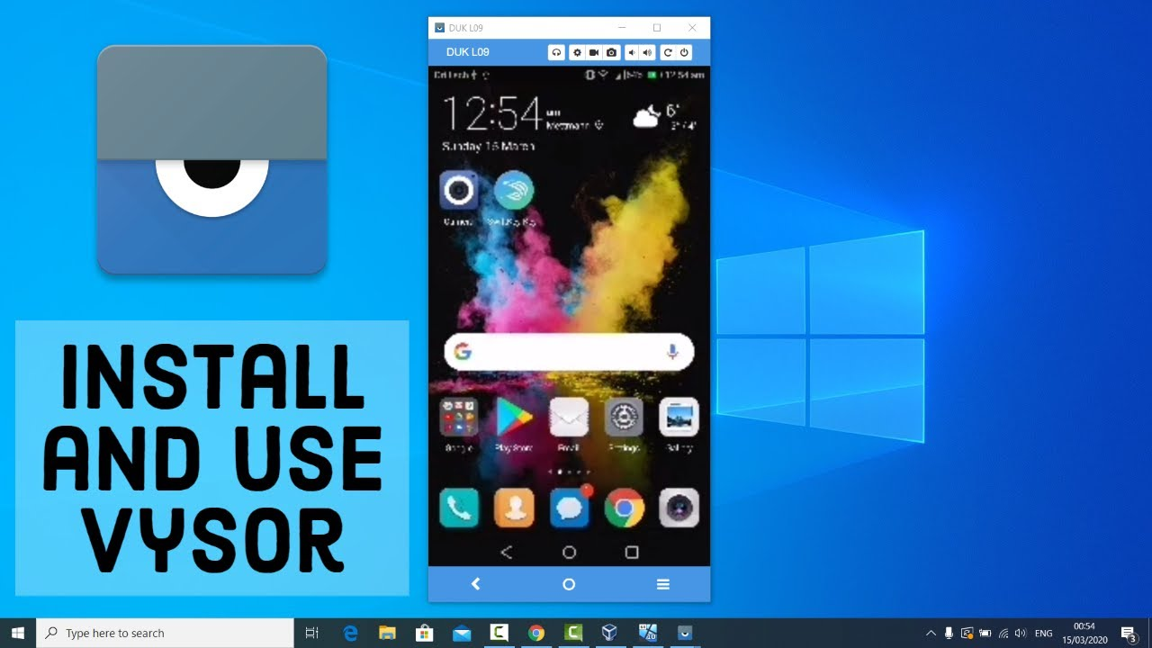
Test your app

Slide 19
Android Developer mode
Open Settings: Access the Settings app on your Android device.
Navigate to About phone: Go to About phone (or About device) within the Settings menu.
Tap Build number: Locate the Build number and rapidly tap it seven times.
Confirm Developer Options: You'll see a message indicating you've enabled Developer Options.
Access Developer Options: The Developer Options menu will now appear in your main Settings menu.

Slide 20

Use case 2
Persona:
Name: Priya
Age: 32
Role: A health-conscious mother of a 6-year-old boy
Goal: To ensure her son eats healthy snacks, avoiding high sugar, additives, or allergens
Scenario:
Priya is grocery shopping on a busy weekday afternoon. Her son loves trying new snacks, but Priya is always worried about hidden sugars, preservatives, and allergy-triggering ingredients. Reading tiny labels on packaging is time-consuming and frustrating.
Key Features of the App:
- Barcode scanning
- Instant nutrition info from Open Food Facts
- Allergen warnings
- Healthy alternatives
- Kid-focused nutritional grading
Benefit:
Priya saves time and makes informed decisions, ensuring her son enjoys tasty snacks without compromising health.

Slide 21
What is JSON – Java Script Object Notation
{
key: ‘value’,
key: ‘value’,
key: ‘value’
}
orderNo shipTo date
101 | SHIP1 | 20251212

Slide 22
What is API?
API stands for application programming interface, it is a contract between our system and a system which is trying to connect with us.
API gives a contract between caller and called party
That makes integration possible w/o knowing internal functionality of system
Critical role in integration and exchange of data between systems
Servers as single entry point for different business objects (so,po,material)

Slide 23
API HUB
SAP provides a publicly available website. Any developer can go and explore the APIs offered by SAP Solutions e.g. S/4HANA, BTP, Success Factors, Field Glass, Concur etc.
https://api.sap.com
You can request S/4HANA server access – server@anubhavtrainings.com

Slide 24
Open APIs
Open Food Facts offers a comprehensive API that allows developers to access a vast database of food product information, including details such as ingredients, nutritional content, allergens, and labels. This open-source database is continually enriched by contributors worldwide, making it an invaluable resource for applications focused on health, diet tracking, food research, and consumer information. citeturn0search0
Key Features of the Open Food Facts API:
- Extensive Data Access: Retrieve detailed information about food products, including ingredients, nutritional facts, allergens, and more.
- Global Coverage: Access data from a wide range of products sourced from various countries, providing a diverse and comprehensive dataset.
- User Contributions: Benefit from a continually growing database, as users worldwide contribute by adding new products and updating existing information.
- Integration Flexibility: Utilize the RESTful API to seamlessly integrate food product data into mobile apps, research projects, software, or diet-based web services.
https://world.openfoodfacts.net/api/0/product/8904004400083?fields=product_name,nutriments,image_front_url
Sample products –
8901764061257
8901262200189
8901063029279
8904004400083

Slide 25

What We Did
Let’s Summarize

Slide 26

www.anubhavtrainings.com
Thank You
End of Day 3

Slide 27


We’re committed to empower you to be
#FutureReady
through powerful training solutions.
We build the workforce of the future.
250+
Corporate Clients
30,000+
Learners Trained
25000+
Learners Placed
FREE WEBINARS
Sign up for free webinars with industry experts every fortnight!
Enroll Now!
Contact us today!
https://anubhavtrainings.com

